Slide 1

AuE-8230 Autonomy: Science and Systems
Capstone Project
Group 1: Chinmay Samak, Tanmay Samak
Codebase

Slide 2
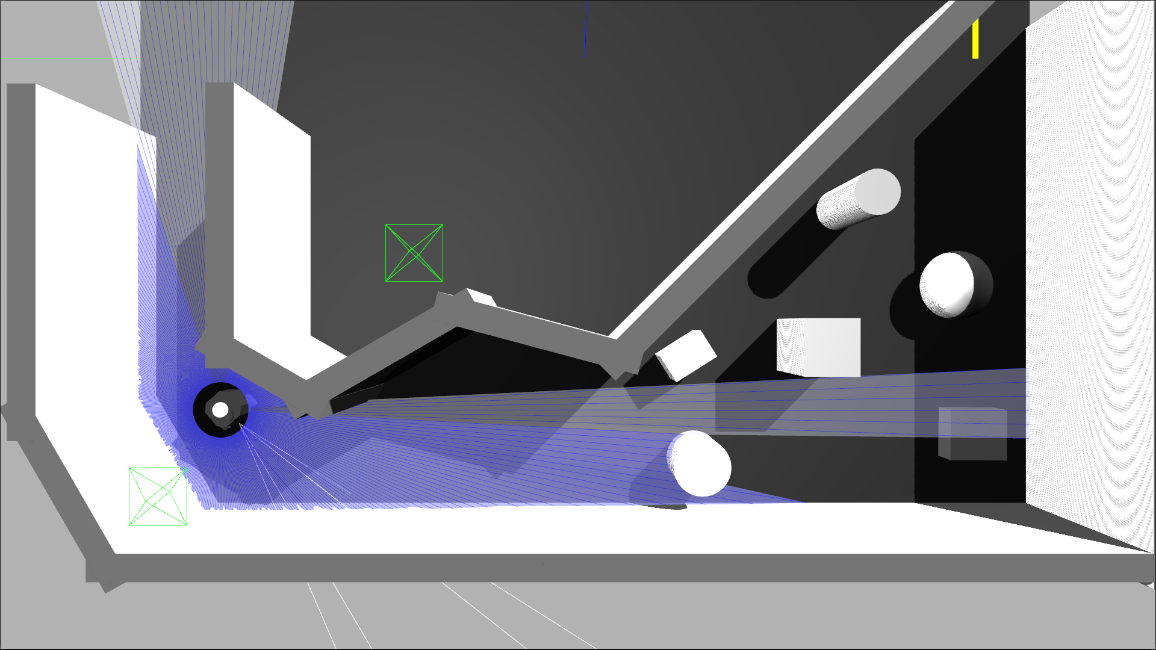
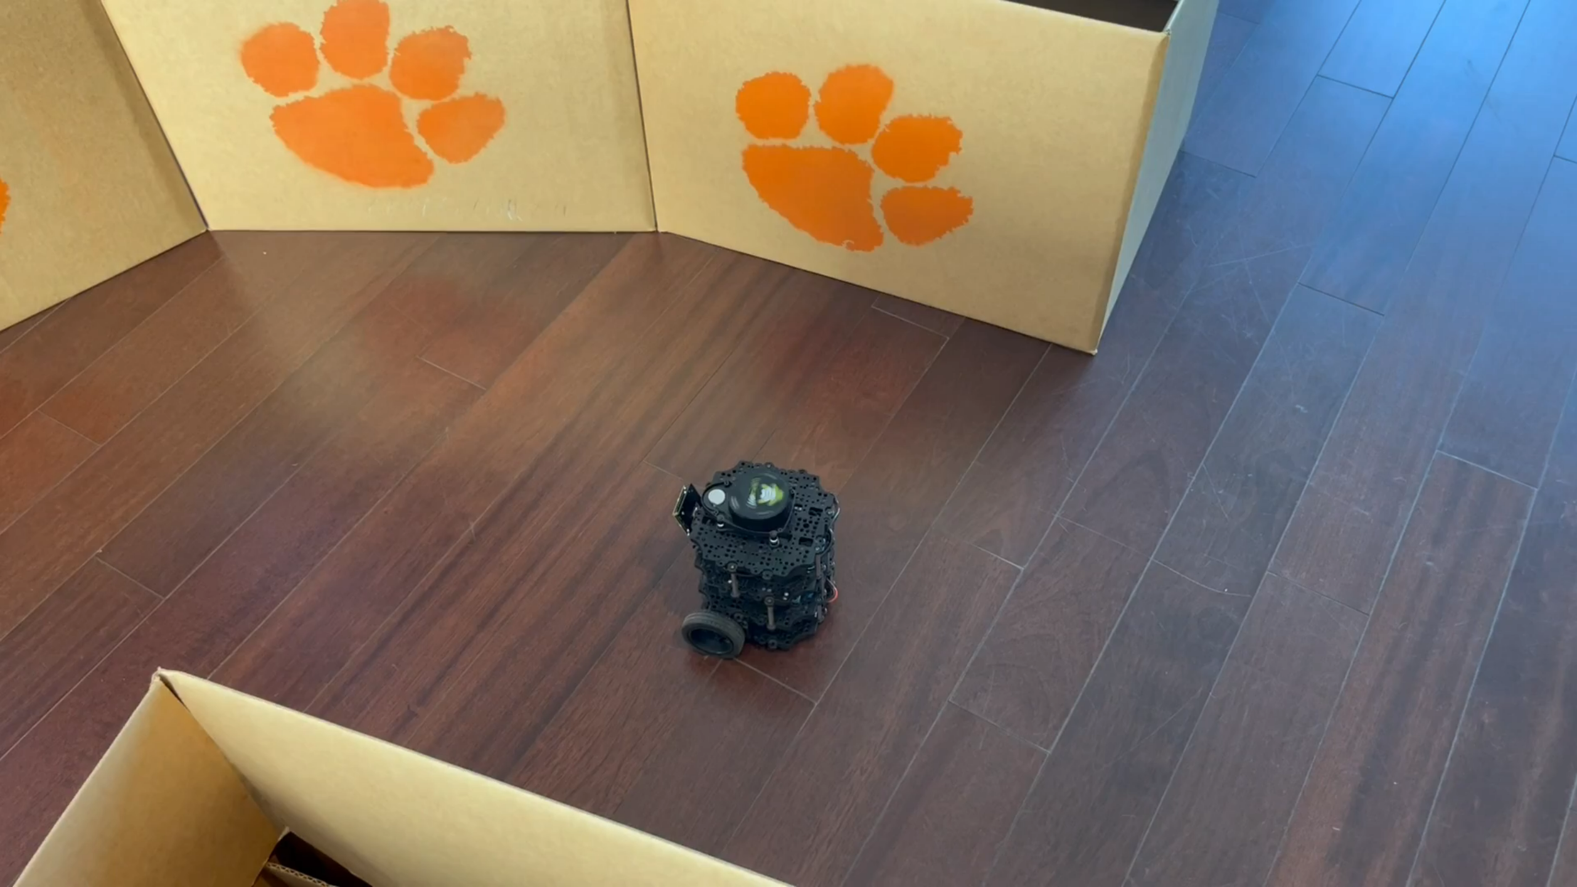
Task 1
Wall Following

Slide 3
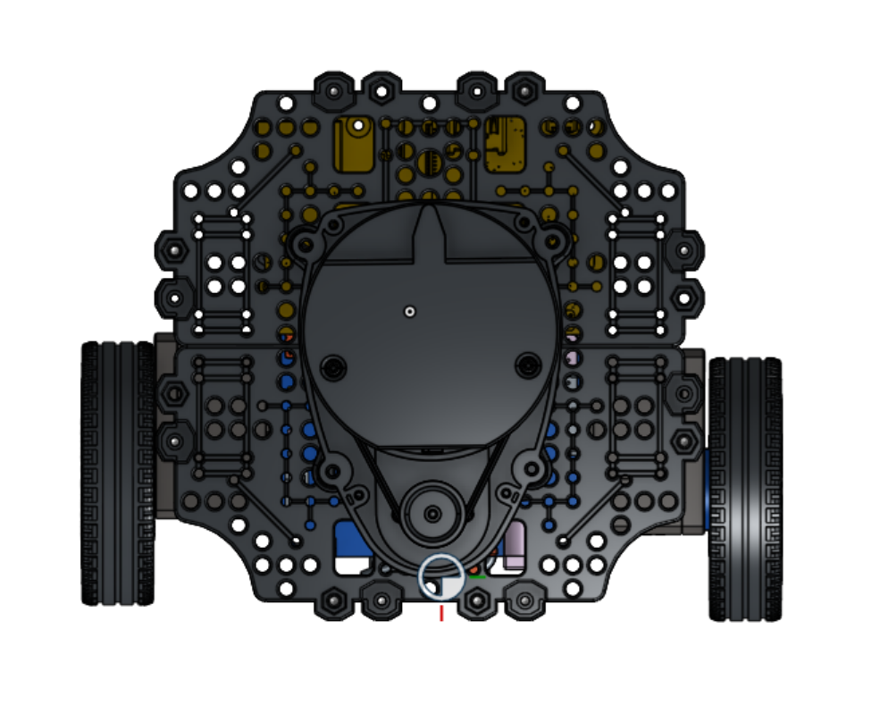
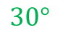
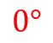
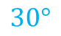
Approach
$$0°$$
Sensors: LIDAR
Algorithm:
Front laser scan ranging measurement [0]
Left [75:105] and right [255:285] laser scan sectors
De-coupled lat-lon PID controller architecture
Adaptive cruise control based on frontal range
Cross-track error based on mean of left and right sectors
Safety (inf range, actuation limits)
Alternate approaches:
Different FOV and orientation of laser scan sectors
CTE based on min, max, mean, wt. mean of sectors
$$30°$$
$$30°$$

Slide 4
Approach
Sensors: LIDAR
Algorithm:
Front laser scan ranging measurement [0]
Left [75:105] and right [255:285] laser scan sectors
De-coupled lat-lon PID controller architecture
Adaptive cruise control based on frontal range
Cross-track error based on mean of left and right sectors
Safety (inf range, actuation limits)
Alternate approaches:
Different FOV and orientation of laser scan sectors
CTE based on min, max, mean, wt. mean of sectors

Slide 5
Approach
START
Initialize
Subscribe Laser Scan
Sensors: LIDAR
Algorithm:
Front laser scan ranging measurement [0]
Left [75:105] and right [255:285] laser scan sectors
De-coupled lat-lon PID controller architecture
Adaptive cruise control based on frontal range
Cross-track error based on mean of left and right sectors
Safety (inf range, actuation limits)
Alternate approaches:
Different FOV and orientation of laser scan sectors
CTE based on min, max, mean, wt. mean of sectors
Front Scan Range
Left Sector Mean
Right Sector Mean
LIN_VEL =
PID_LON(FSR)
CTE = LSM - RSM
CTE is
-inf?
No
CTE is
inf?
No
Yes
Yes
ANG_VEL =
-0.1 rad/s
ANG_VEL =
0.1 rad/s
ANG_VEL =
PID_LAT(CTE)
Bound LIN_VEL
Bound ANG_VEL
Publish CMD_VEL =
{LIN_VEL, ANG_VEL}
END

Slide 6

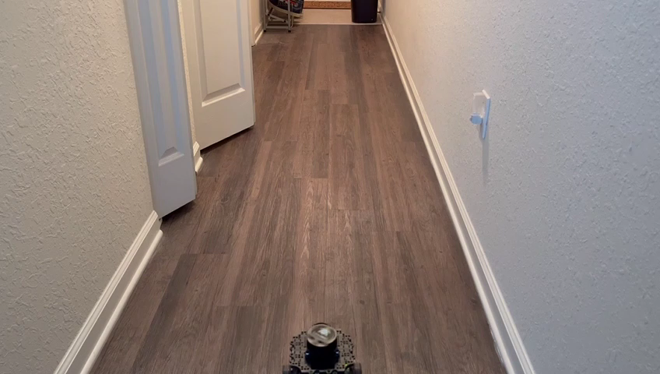
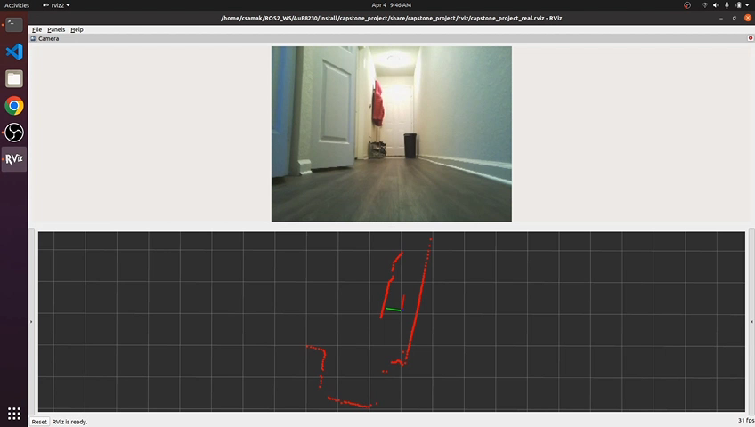
Results
Simulation
TurtleBot3
Remote PC

Slide 7
Thank you!
…open to questions and suggestions

